Slide 1

Statistical & Machine Learning
Minh PHAN
Group project: In Class Kaggle competition
Notes:
Sofie

Slide 2

AGENDA
TEAM PRESENTATION
DATA SUMMARY AND PROCESSING
METHODOLOGY
RESULTS
SOLUTION IMPLEMENTATION

Slide 3

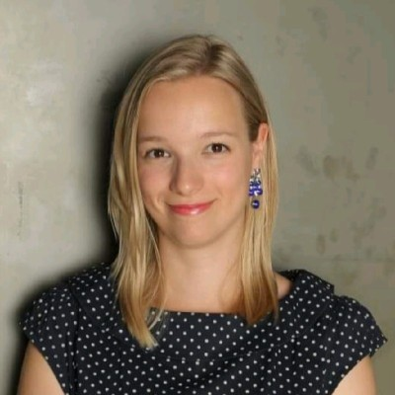
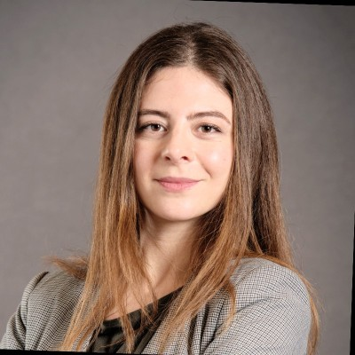
4 FROMAGE PIZZA
Fernando Delgado
Sofie Ghysels
Nour Azar
Used to work in finance as a Global Business Services Trainee, but the hunger for data (and pain au chocolat) led him to…. France and an MSc in Big Data Analytics. He is an expert in data wrangling, predictive modelling and out-of-the box thinking. When he's not asking “how can we improve our Kaggle score“, he enjoys eating Mexican food, travelling and playing music.
Has a background in HR, international trade and communications and has worked in various HR roles at multinational companies in Belgium and France. She has a knack for organization and a passion for reporting and data visualization tools. When not scheduling in team meetings or sharing Belgian chocolates with her colleagues, Sofie can be found watching reality series, walking or hanging out with friends.
Has more than five years of experience as an accountant and external auditor in highly demanding environments. She is known for her critical thinking skillset and problem-solving abilities. Nour has a passion for machine learning and enjoys getting her hands dirty during all aspects of the modelling pipeline. Nour did community volunteering in her home country Lebanon and in her free time you might see her eating delicious food and getting outside.
Statistical and Machine Learning Approaches for Marketing
Notes:
Sofie

Slide 4

BUSINESS PROBLEM
Portuguese Bank Telemarketing Campaign
Classification Goal → Subscribe or Not
Success of Bank Telemarketing
Notes:
Sofie
Telemarketing is a direct marketing practice, by which goods or services are adverted to potential customers over the telephone. Telemarketing is mostly carried out by an external specialized telemarketing service. The issue is that nowadays consumers often see telemarketing is as intrusive. Therefore, to maintain a good reputation and to not increase the churn rate, it is paramount to effectively target the customers.
A Portuguese bank has approached us to provide them a data-driven approach to predict the success of their telemarketing campaign.
The main objective of this project is to increase the success of telemarketing, as in predicting if a client will subscribe a term deposit or not after the bank’s telemarketing campaign.
This project can also serve as a guidance map for marketing to establish a target customer profile for future marketing campaigns.

Slide 5



DATA SCIENCE PROBLEM
Problem Type
Data-Science Tools
Expected Results
Classification Supervised (Yes/No 1 or 0)
Logistic Regression
Random Forest
Gradient Boosting
K Nearest Neighbors
Support Vector Machine
Model evaluation with AUC to perform predictions: probability of subscribe
Statistical and Machine Learning Approaches for Marketing
Notes:
Sofie

Slide 6
DATA SUMMARY
Number of Observations
10,000
20,000
TEST
TRAIN
Variables
Predictors
9 Numerical Variables
10 Categorical Variables
Target
Subscribe/ not subscribe
Statistical and Machine Learning Approaches for Marketing

Slide 7
DATA SUMMARY
Missing Values by Variable Type
Statistical and Machine Learning Approaches for Marketing

Slide 8
DATA SUMMARY
Outliers in Numerical Variables
We decide not to remove outliers since they are similar on both sets
Statistical and Machine Learning Approaches for Marketing

Slide 9
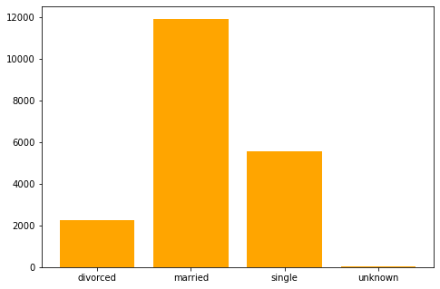
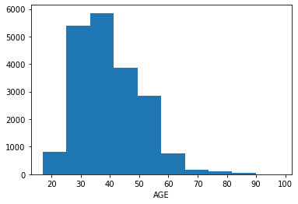
DATA SUMMARY
Marital Status Distribution
Age Distribution
Statistical and Machine Learning Approaches for Marketing

Slide 10
DATA SUMMARY
Target Variable Distribution
Target variable not equally distributed.
Statistical and Machine Learning Approaches for Marketing

Slide 11
PRE-PROCESSING DATA
Available Data
Train
Test
Train Test Split
Train
Validation
Test
80%
20%
Statistical and Machine Learning Approaches for Marketing

Slide 12
PRE-PROCESSING DATA
Error Correction
Outliers
Missing Values
Numericals: mean and mode. « Missing » tracker column
Categoricals are filled with « missing »
Statistical and Machine Learning Approaches for Marketing

Slide 13
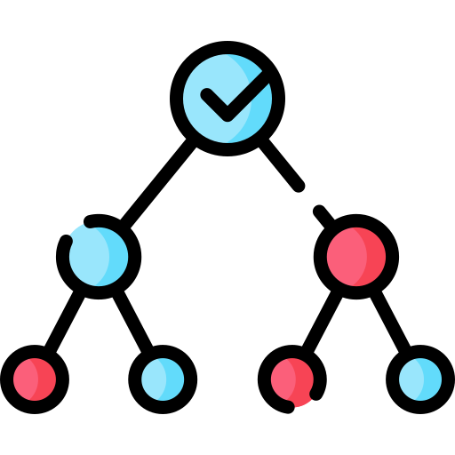
PRE-PROCESSING DATA
Ordinal Encoding for Categoricals
Decision Tree-Based Remapping
Numericals and Categoricals
Statistical and Machine Learning Approaches for Marketing

Slide 14

FEATURE ENGINEERING
Since all variables are anonymized, we can’t create features based on meaning:
Age
Cons.conf.idx
Polynomial Features
Statistical and Machine Learning Approaches for Marketing

Slide 15
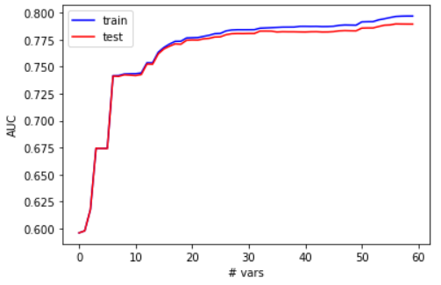
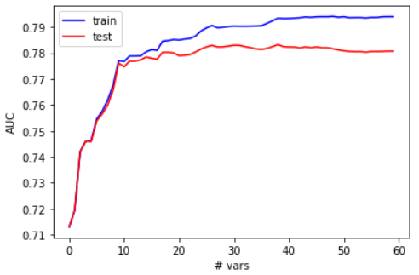
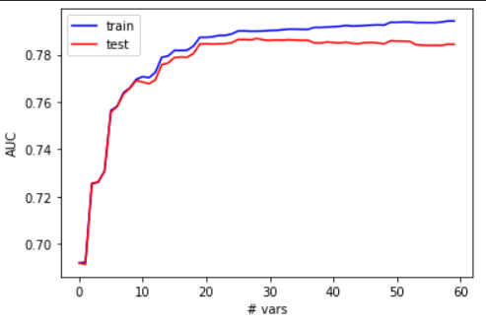
VARIABLE SELECTION
With Fisher Score Methodology, out of 194 Variables we select the best 55:
Decision-tree based re-mapping
Equal Frequency Discretization
Equal Width Discretization
Statistical and Machine Learning Approaches for Marketing

Slide 16
METHODOLOGY
Model Evaluation with Validation AUC
We fit models to 5 different classification methods.
Statistical and Machine Learning Approaches for Marketing

Slide 17
METHODOLOGY
Hyper Parameter Tuning
Logistic Regression is the best performer.
Statistical and Machine Learning Approaches for Marketing

Slide 18
EXPERIMENTAL SETUP
Fit the model to the train set
Evaluate the model with the validation set
Cross-validate the model to obtain mean AUC
Re-fit model on the full train set
Cross-Validate the last fitted model
Statistical and Machine Learning Approaches for Marketing

Slide 19
RESULTS
Cross Validated AUC on Full Train Set
Statistical and Machine Learning Approaches for Marketing

Slide 20

Our model can accurately predict with 80% accuracy whether a client will subscribe for a deposit after a bank telemarketing campaign.
Notes:
Sofie

Slide 21


Team 4 fromage pizza thanks you for listening!
Notes:
Sofie Ending

